Slide 1
Carrier Sense Multiple Access(CSMA)
By,
A.JOTHIMANI

Slide 2
CSMA
Its concept is simply listen before talk (LBT)
• If channel is sensed idle : transmit entire frame
• If channel is sensed busy : defer transmission
• We could achieve better throughput if we could listen to the channel before transmitting a packet
• This way, we would stop avoidable collisions
• To do this, we need CSMA protocols

Slide 3
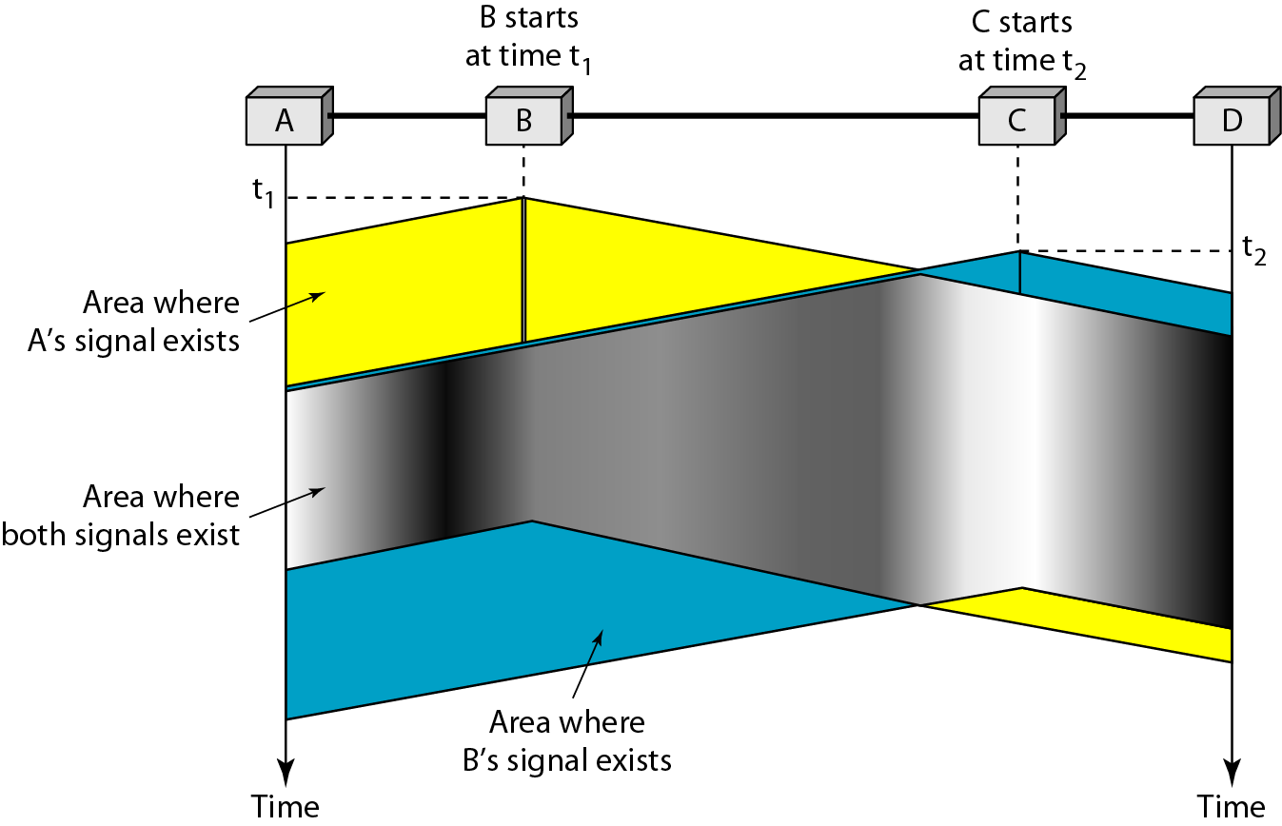
Figure Space/time model of the collision in CSMA

Slide 4
CSMA
CSMA requires that each station first listen to the medium before sending.( Sense before transmit)
It can reduce the possibility of collision, but it cannot eliminate it.
The possibility of collision still exists because of propagation delay.
A station may sense the medium and find it idle, only because the first bit sent by another station has not yet been received.
At time t1, station B senses the medium and find it idle, so it sends a frame.
At time t2(t2>t1), station c senses the medium and finds it idle because at this time, the first bits from station B have not reached station C. station C also sends a frame.
The two signals collide and both frames are destroyed.

Slide 5
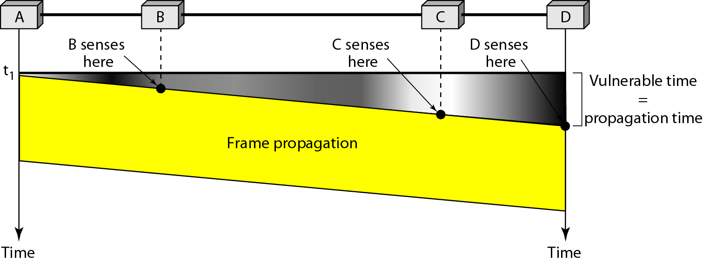
Vulnerable time in CSMA
Propagation time Tp- time needed for a signal to propagate from one end of the medium to the other.
The leftmost station A sends a frame at time t1, which reaches the rightmost station D at time t1+Tp.

Slide 6
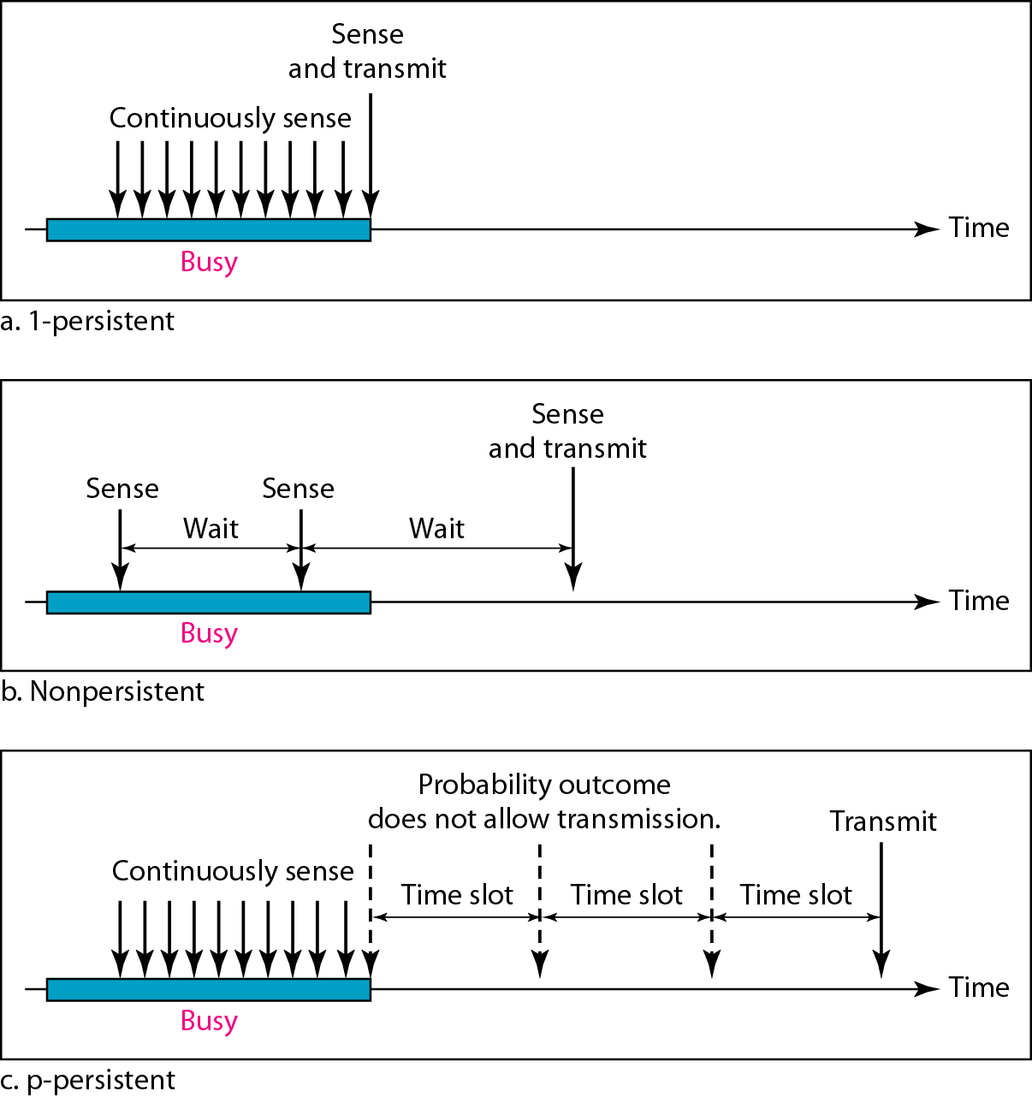
Contd..
With probability p, the station sends its frame.
With probability q=1-p, the station waits for beginning of the next time slot and checks the line again

Slide 7
1-Persistent CSMA
• Sense the channel – If busy, keep listening to the channel and transmit immediately when the channel becomes idle – If idle, transmit a packet immediately.
• If collision occurs – Wait a random amount of time and start over again 1-Persistent CSMA
This protocol is called 1-persistent because the host transmits with a probability of 1 whenever it finds the channel idle

Slide 8
P-Persistent CSMA
• Applicable to slotted channels
• When a station becomes ready to send, it senses the channel – if it is idle, station transmits with a probability of p – it defers until next slot with a probability of q = 1-p
• If the slot is also idle – either station transmits or it defers with probabilities of p & q
• This is repeated until either the frame has been transmitted or another station begun transmitting

Slide 9
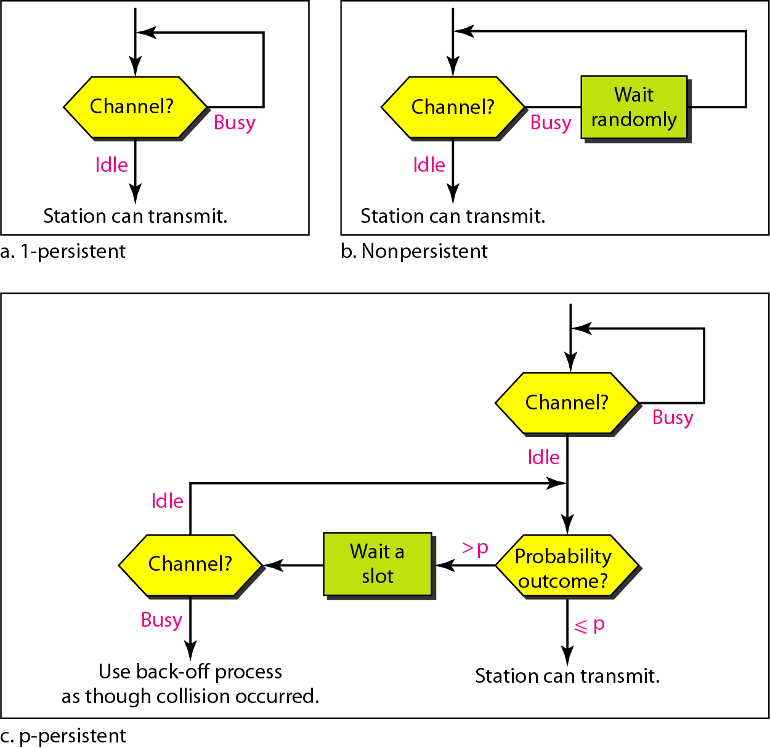
Figure Flow diagram for three persistence methods

Slide 10
CSMA efficiency
Decreases with t (prop) / t (trans)
• Decreases with increasing distance between nodes
• T (trans) = R / L where R is the link speed in bits/sec and L is the frame length in bits
• So, efficiency decreases with increasing link speed R

Slide 11
CSMA/CD Carrier Sense Multiple Access / Collision Detection
Sending nodes are able to detect collisions while transmitting
• If medium is idle , transmits
• If busy, listens for idle then transmits
• While transmitting node continues to listen to see if a collision has occurred
• If collision detected stops transmission, generates a jamming signal on the bus to indicate all nodes about collision

Slide 12
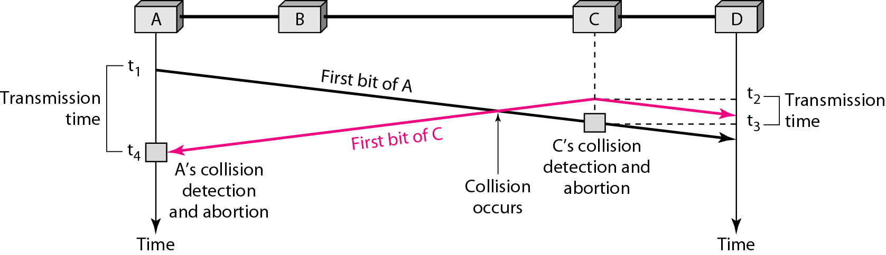
CSMA/CD

Slide 13
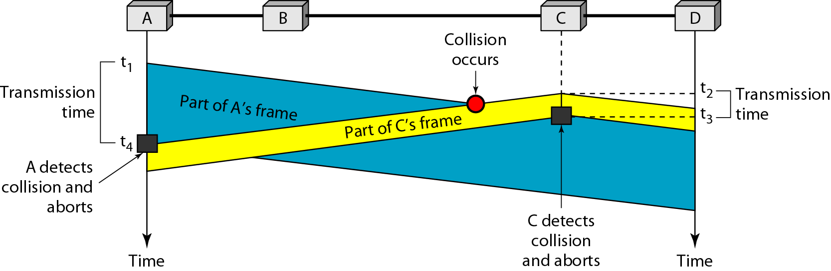
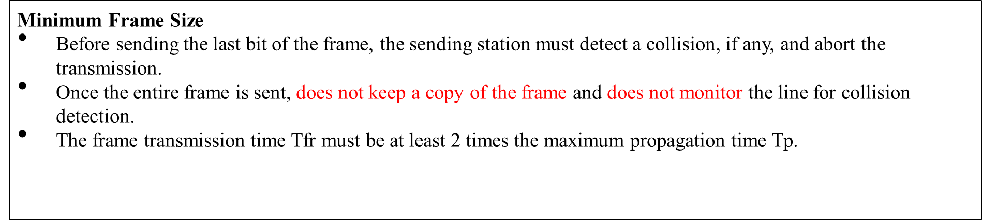
Figure Collision and abortion in CSMA/CD

Slide 14
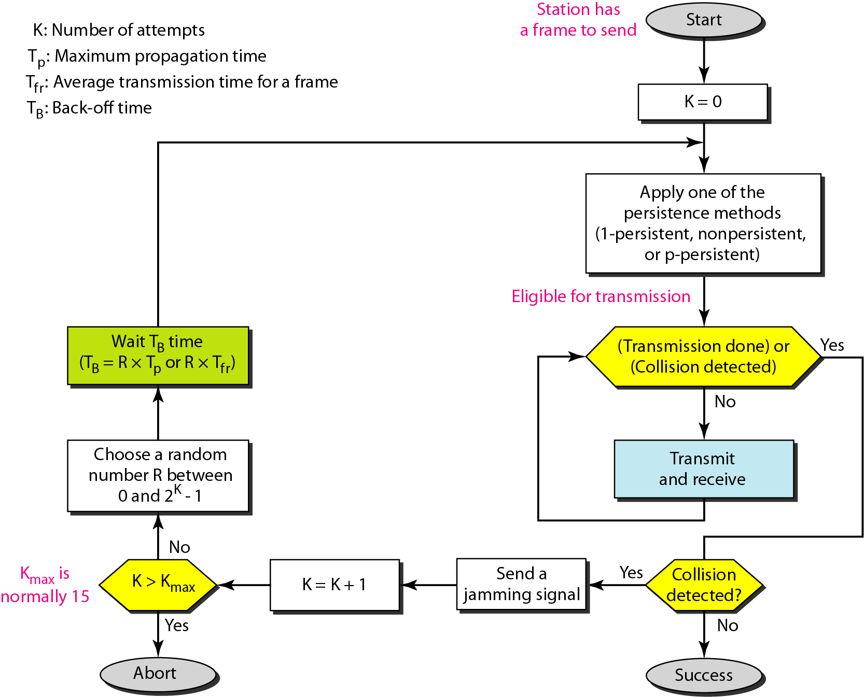
Flow diagram for the CSMA/CD

Slide 15
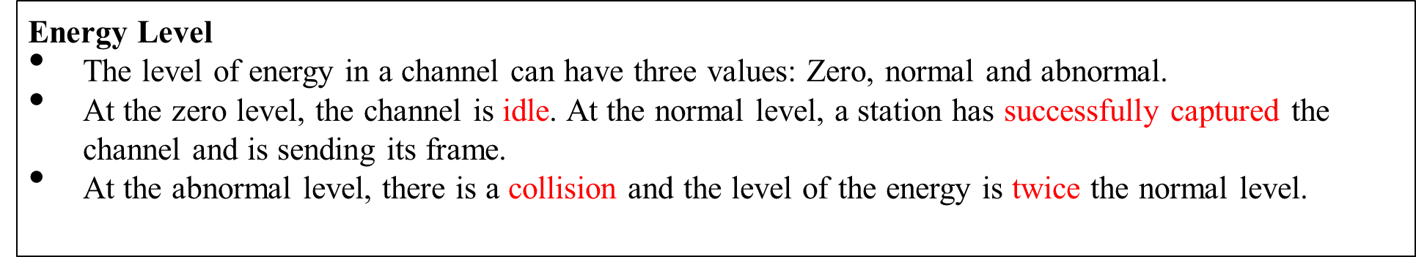
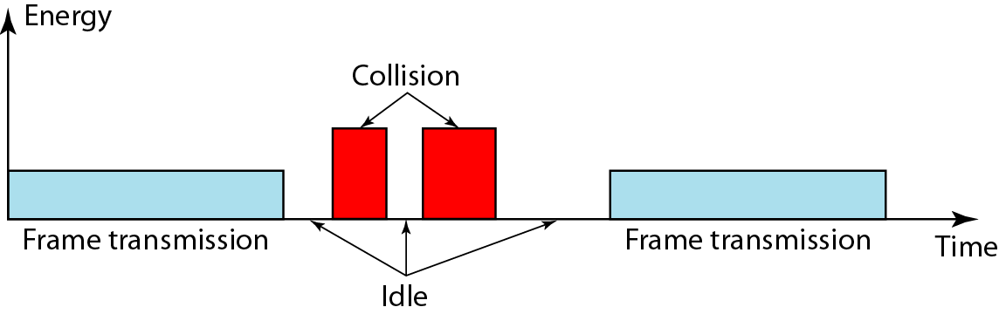
Energy level during transmission, idleness, or collision

Slide 16


Hamming Code
The Hamming distance between two words is the number of differences between corresponding bits.
It can easily be found if we apply the XOR operation on the two words and count the number of 1s in the result.
Let us find the Hamming distance between two pairs of words.
1. The Hamming distance d(000, 011) is 2 because
2. The Hamming distance d(10101, 11110) is 3 because

Slide 17
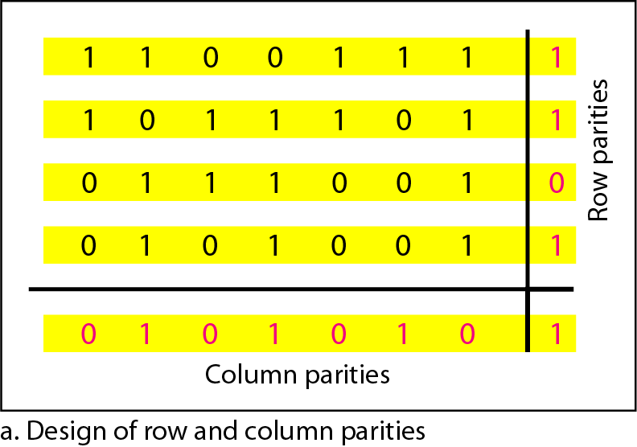
Hamming Distance
The code were originally designed with d_{min=3}, which means that they can detect up to 2 errors or correct 1 single error.
We need to choose an integer m>=3. The values of n and k are then calculated from m as n=2^{m} -1 and k=n-m. The number of check bits r = m.
If m=3, then n=7 and k=4. Hamming code C(7,4) with d_{min} =3.
Two-dimensional
parity-check code

